Slide 1
MSR course 2020/21 at uniko, CS department, Software language team Shray Sharma
Course assignment presentation;
Reading the paper ” On effectiveness of manual and automatic unit test generation : Ten Years later”
Authors: Domenico Serra, Giovanni Grano, Fabio Palomba, Filomena Ferrucci, Harald C. Gall, Alberto Bacchelli

Slide 2
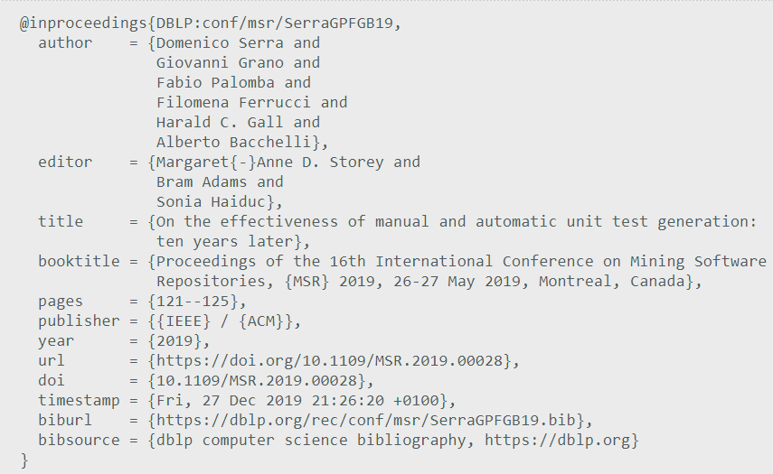
Full Citation
https://dblp.org/rec/conf/msr/SerraGPFGB19

Slide 3

Testing plays a very important role in software development life cycle in guaranteeing the quality of a product. Specially in the context of continuous integration where the developers are performing both the tests including integration and unit testing.
This process of testing can be enhanced with the use of automation tests which can then lead to having some positive and negative sides. The paper under discussion Serra et al[1] is a reproduction of Bacchelli et al.[2] comparing the growth of automation testing over the span of 10 years.
This comparison is answered by the below mentioned research questions for Serra et al[1] :
RQ1: What is the code coverage of manual and automated tests?
RQ2: What is the mutation score of manual versus automated tests?( ability of test case to cover variation in code that makes it defective)
RQ3: what is the fault detection ability of manual tests versus automatically generated ones.
Motivation

Slide 4
Data Collection
The data used by Bacchelli et al.[2] was not made public and the only information given out was that it used FREENET project [3]. As to get a best comparison the data set had to remain the same and the tools for automation of unit testing had to be changed. The data was extracted in three steps:
Detecting Manually written regression tests:
The authors of Serra et al[1] started by scanning each commit of the version history of FREENET and looking for T^{C}_{i} , namely the commit i that firstly introduced the test suite T for the class c. Since the test suite followed the naming convention that dictates that each test has the suffix Test after the name of the tested production class, the paper could do an accurate mapping between tests and the corresponding production classes Detecting defective classes.

Slide 5
Data Collection
Detecting defective classes.
The authors of Serra et al[1] executed a test suite introduced at T^{c}_{i} over the previous commits of c: to see if T fails on the production class in a certain commit c_{i}, it was assumed that one defect is found. The procedure was repeated until all the defects declared in the reference paper are found.
Generating automatic regression tests.
Once the authors of Serra et al[1] identified the set of defective classes and their fixes, they could generate regression tests automatically. To have an overview of the performance of different existing tools, the paper considered three testing tools, namely EVOSUITE [3], RANDOOP [4],and JTEXPERT [5]

Slide 6
Data Analysis
The paper Serra et al[1] strictly focuses to address the research questions, the paper first computes line coverage (RQ1) and mutation score (RQ2) for both manually and automatically written test suites. To compute the mutation score the paper relies on PIT [22].
To answer RQ3, the paper Serra et al[1] computes the number of times manually and automatically generated tests can correctly identify a failure: for the automated tests, it was considered a failure to be detected if the tools identify it in at least one of the runs

Slide 7
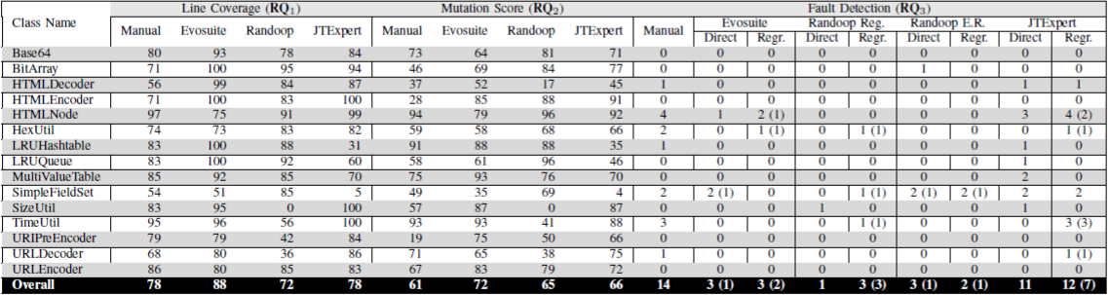
Data Analysis
Serra et al[1]

Slide 8
Results
The paper Serra et al[1] comes to a clear conclusion by answering all the research questions.
The findings of Serra et al[1] revealed that current automatic test case generation tools can optimize coverage and mutation score more than manually written tests
The improvement in the last ten years has not been dramatic. In terms of defect finding, while there has been little improvement over the last years, it has not reached the same level of quality as the other dimensions.

Slide 9
Reproducibility
The paper Serra et al[1] has made its data set public which can be used as a base to compare the unit testing tools upon and come to a clear conclusion and define if there has been improvements.
The paper heavily relies on usage and acquiring of test automation tools, to which the data from step 1 can be fed and the results can be compared.
The problem in reproducing this paper would come in acquiring the licenses for the tools to create a clear comparison of the development of tools over time.

Slide 10
References
D. Serra, G. Grano, F. Palomba, F. Ferrucci, H. C. Gall and A. Bacchelli, "On the Effectiveness of Manual and Automatic Unit Test Generation: Ten Years Later," 2019 IEEE/ACM 16th International Conference on Mining Software Repositories (MSR), Montreal, QC, Canada, 2019, pp. 121-125, doi: 10.1109/MSR.2019.00028.
A. Bacchelli, P. Ciancarini, and D. Rossi, “On the effectiveness of manual and automatic unit test generation,” in The Third International Conference on Software Engineering Advances. IEEE, 2008, pp. 252–257.
G. Fraser and A. Arcuri, “Evosuite: automatic test suite generation for object-oriented software,” in Proceedings of the 19th ACM SIGSOFT symposium and the 13th European conference on Foundations of software engineering. ACM, 2011, pp. 416–419.
C. Pacheco, S. K. Lahiri, M. D. Ernst, and T. Ball, “Feedback-directed random test generation,” in Proceedings of the 29th international conference on Software Engineering. IEEE Computer Society, 2007,pp. 75–84.
A. Sakti, G. Pesant, and Y.-G. Guéhéneuc, “Instance generator and problem representation to improve object oriented code coverage,” IEEE Transactions on Software Engineering, vol. 41, no. 3, pp. 294–313, 2015.

